Slide 1



Multi-Domain Service Provisioning for Advanced Applications
Network & Service
Management Group
School of Computer Science
University of Waterloo

Slide 2
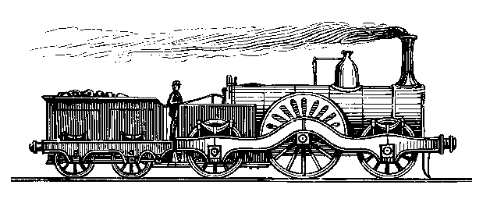
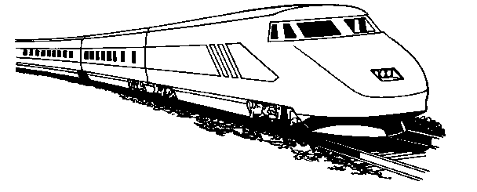
CA*net 4
Internet
Edmonton
Saskatoon
Vancouver
Winnipeg
Calgary
Regina
Halifax
Kamloops
Thunder Bay
Victoria
St. John's
CA*net 4
Quebec City
Charlottetown
Seattle
Sudbury
Montreal
Ottawa
Fredericton
Halifax
Minneapolis
Toronto
Kingston
CA*net 4 Node
Buffalo
London
Boston
Possible Future Breakout
Hamilton
Albany
Possible Future link or Option
Windsor
Chicago
CA*net 4 OC192
New York
CANARIE ANW, Halifax, Nov. 23th, 2004
Notes:
With the increasing collaboration and knowledge exchange among academia and industry, there is a pressing needs for QoS-assured communications (e.g. teleconferencing, distant learning, etc.). Currently, such setup requires specialized equipment and private line leasing, and possibly days of booking in advance. Internet-based solutions remain flaky in its QoS delivery. The CA*net 4 is born with a strong purpose in mind: to facilitate a full optical infrastructure that supports such advanced applications on short notice and with assured quality. It does this by providing a high speed optical pathway (OC192), using the concept of end-to-end lightpath constructions, and push for user-controlled provisioning and management of lightpaths.
NOTE: picture taken from Bill’s presentation

Slide 3




Advanced Application Scenario: National Virtual Conferencing
CANARIE ANW, Halifax, Nov. 23th, 2004
Notes:
To illustrate the ultimate objective of Canarie and the purpose of this project we present a couple of advanced application scenarios. National Virtual Conferencing can be envisioned as the “teleconferencing” in grand scale. Many researchers across the country wish for a hassle-free and efficient method of remote collaboration. Current teleconferencing service remains expensive and out of the reach of most populace. The CA*net 4 with its wide reachability can facilitate such service.

Slide 4
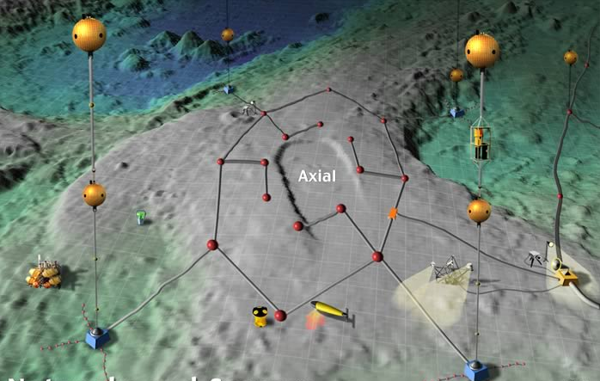
Advanced Applications: Scientific Experiment Collaboration
CANARIE ANW, Halifax, Nov. 23th, 2004
Notes:
Scientific experiment collaboration is another promising venture. The figure illustrates the NEPTUNE Canada sensor net that is deployed off the coast of Vancouver Isle. It is an cutting-edge oceanic observatory that is connected to the CA*net 4 infrastructure for information delivery.

Slide 5




Advanced Applications: Scientific Experiment Collaboration
CA*Net 4
NEPTUNE Canada
CANARIE ANW, Halifax, Nov. 23th, 2004
Notes:
Because of the prohibitive cost and logistics involved in setting up experiment, collaboration among participants remotely is a highly desired service. The sensor net is controlled remotely on shore, the vast amount of data gathered needs to be processed off-site. Other researchers may participant in the experiment across the country. Real time sensor results and analysis may be made available for observations among many sites.

Slide 6
The Challenges (1)
What do we have now?
Open standard for distributed computing
  Web service, Grid service, etc.
Framework for dynamic service composition
  WSFL, BPEL4WS, WSIL, WSRF, etc.
User-controlled light path provisioning
  UCLP for intra-domain light path setup
What is missing?
Cross-domain QoS managed service provisioning
CANARIE ANW, Halifax, Nov. 23th, 2004
Notes:
To support these advanced applications, a number of research innovations and technology support are needed.
What do we have now?
Open standard for distributed component to communicate using standardized protocols and interfaces: Web Service and Grid Service are a few examples for this. In fact, it is becoming THE standard for loosely-coupled interactions among software components. Because of the need for dynamic construction of these applications at runtime, some form of framework for dynamic service composition is required. Current works on Web Service Flow Languages, Business Process Execution Language for Web Services (both headed by IBM), and Web Service Inspection Languages offers a good starting point. It is very interesting for us to see how such tools and concept can be applied to end-to-end multi-domain network provisioning involving virtual network resources (e.g. virtual lightpath objects, it may be interesting to note UCLP allows for creating of lightpath objects that can be managed and manipulated in many ways, concatenation, partitioning, etc.) The UCLP light path provisioning is successfully deployed in CA*net 4 for end-to-end lightpath provisioning in intra-domain. It is logical to now extend this concept to multi-domains (among CA*net 4 collaborates) and involving multi-technologies.
What is missing?
The multi-domain aspect! To realize the envisioned advanced applications, cross-domain QoS managed service provisioning is a very challenging topic, and the focus of this project

Slide 7

The Challenges (2)
Research Collaborator
Research Collaborator
Audience
Remote Controller
Remote Controller
Media Player
Sensor Net
Command Interpreter
Audience
Data Processor
Media Player
Data Management
Visualization
Audience
Data Processor
Media Player
Multi-Technology Service Segment, including UCLP
More than just setting up lines!
Cross domain service naming and discovery
Inter-domain routing, cross-domain negotiation and path setup
End-to-end QoS assurance and management
CANARIE ANW, Halifax, Nov. 23th, 2004
Notes:
The figure here shows the possible interactions among software components and equipments to facilitate collaborative scientific experiment (e.g. for NEPTUNE Canada). Each of the lines between components are a dynamically configured network segments that support the QoS requirements of the communicating components. Depending on the locations of the components, an end-to-end path here could actually be a concatenation of multiple network service segments. The popup shows how an end-to-end lightpath could be consisting of multiple lightpath segments. (this is actually a simple case … imagine path involving heterogeneous technology segments across a number of domains!)
In such complex cases, it is much more than just configure a bunch of network resources!
Cross domain service naming and discovery needs to be done to find out what resources are available and how to access them
Inter-domain routing needs to be performed to determine the participating domains and cross-domain negotiation must be conducted to setup cross-domain path connection. All of these have to inter-work with existing intra-domain path construction mechanisms and QoS measures
Somehow, end-to-end QoS requirement (of the components) needs to be met and the path may have to be monitored and managed to ensure its quality

Slide 8
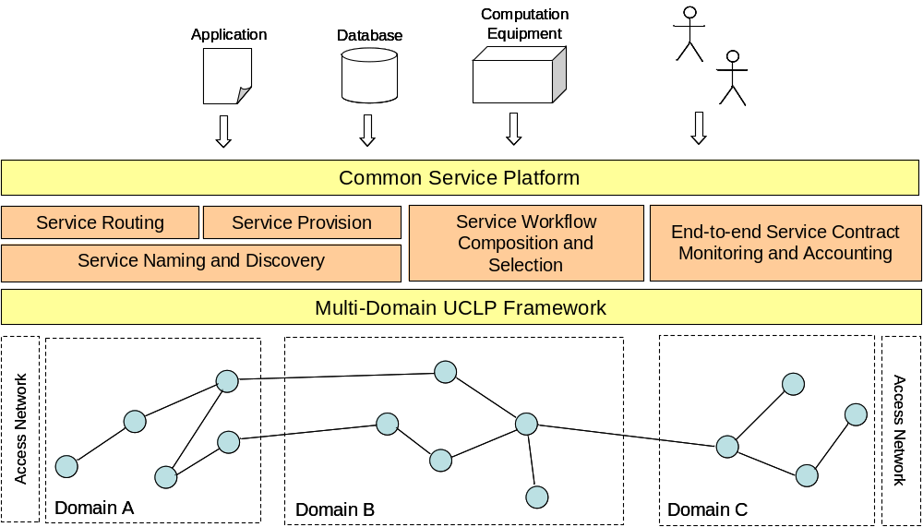
A Multi-Domain Service Provisioning Framework
CANARIE ANW, Halifax, Nov. 23th, 2004
Notes:
In this project, we envision a common service platform to support dynamic end-to-end path creations and management for distributed communicating components.
Multi-domain UCLP Framework: The UCLP toolkit allows for intra-domain lightpath setup, we extend this concept to multiple domains (Activity: Inter-domain Provisioning) and inter-work with provisioning mechanisms at the access network to provide full end-to-end path construction.
To make this possible, a number of core functions is required in the platform.
Service naming and discovery: cross-domain naming and discovery tells us what resources are available and how to access them.
Service Routing: what path segments to use and how to span them between source and destination, what additional segments are needed to make up the full path?
Service Provisioning: the actually path establishment end-to-end, requires both path endpoint connection (intra-domain) and cross-domain path setup (if endpoints are in different domains).
Service Workflow Composition and Selection: making sure the path setup is valid (e.g. no conflicting channel assignments, invalid cross-connects, etc.), QoS requirements are met, and monitoring and management functions (if any) are created properly.
End-to-end service contract monitoring and accounting: facilities for monitoring and usage accounting (outside the scope of this project, nevertheless an important function)
Common Service Platform: the middleware that brings together the core functions and provide the applications and users with a unified access interface.

Slide 9






Multi-Domain Provisioning Overview
CANARIE ANW, Halifax, Nov. 23th, 2004
Notes:
Overview of the multi-domain provisioning process supported by the common service platform.
Two users/applications desire to establish an end-to-end lightpath (in this case) between them.
The service naming and discovery function acquires information on available lightpath segments meeting the requirement (the same function is also used to locate other crucial functions, such as provisioning function, workflow function, monitoring function, etc.).
Service routing function helps to determine what domains (and lightpath segments) should be involved along the path.
Service provision function, with the help of M-D UCLP, creates new lightpath segments spanning the “gaps” en route (to create cross-domain lightpath segments, inter-domain negotiation must also take place long with cross-domain connection setup) and establish lightpath segment connections.
Service workflow ensures the composition is valid, meets user requirements and does not violate domain access policies. End-to-end monitoring and account are also setup at the same time, workflow can also help in configuring these management functions.
Through a unified access interface (as provided by the common service platform interface), the users can quickly setup end-to-end QoS managed lightpath efficiently and hassle-free. Such lightpath can then be considered as a lightpath resource subject to further provisioning operations (e.g. concatenation, partitioning, leasing, etc.), offer a wide range of possibilities with economic incentive?

Slide 10
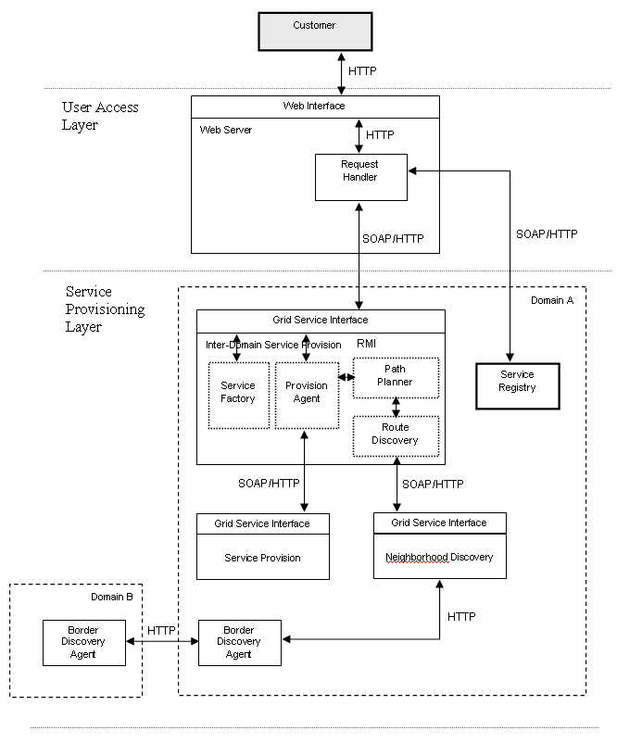
CANARIE ANW, Halifax, Nov. 23th, 2004

Slide 11
Research Activities (1)
Service naming and discovery
  A unified scheme for naming network resources and services across domains
  Inter-domain discovery mechanism of network resources and services
Multi-domain service routing
  Domain discovery and reachability
  Inter-domain service routing and intra-domain lightpath selection
CANARIE ANW, Halifax, Nov. 23th, 2004

Slide 12
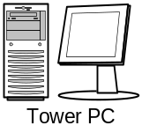
Local Service
Registry
P2P Indexing
Node
P2P Cross-Domain Service Discovery
User Agent
Service Agent
Policy Server
Service Broker
Peer
Communication
component
interaction
Domain B
Service
Domain C
Domain A
CANARIE ANW, Halifax, Nov. 23th, 2004

Slide 13
Research Activities (2)
Inter-domain service provisioning
  Inter-domain service negotiation (e.g. Management by Contract, SLA management works)
  Application QoS mapping and inter-domain path connections
Common service platform
  Platform infrastructure design and core service function specifications
  Service component and network resources (including lightpath objects) management
  Support for service contracting and inter-domain negotiations
CANARIE ANW, Halifax, Nov. 23th, 2004

Slide 14
Research Activities (3)
Service workflow and selection
  Evaluation of existing workflow tools for multi-domain service composition
  Workflow scheme for end-to-end multi-domain lightpath composition
Example applications
  Utilization of common service platform to support advanced application examples.
CANARIE ANW, Halifax, Nov. 23th, 2004

Slide 15
Some Design Issues
Technology heterogeneity
System scalability and extensibility
Domain administrative independence
Provisioning efficiency and correctness
QoS awareness
The common service platform is not only for service provisioning of end-to-end lightpaths, but can also be augmented to support other FCAPS management.
CANARIE ANW, Halifax, Nov. 23th, 2004
Notes:
Technology heterogeneity: we expect to deal with many heterogeneous network technologies, discovery mechanisms, provisioning schemes, and QoS management methods. One key challenge of multi-domain provisioning is to find effective and scalable solutions that can inter-work with such diversity and insolates this factor from the applications and users.
System scalability and extensibility: not only does the architecture have to scale and provide graceful degradation, the operations of provisioning must also be scalable and resource conscious. The platform should be extensible to support future addition of functions, and to insolate the users/applications from internal modification of existing functions.
Domain administrative independence: respect the administrative solidarity of domains, work with only information a domain can provided and utilize existing provisioning infrastructures in a domain, rather than forcing uniformality across all domains.
Provisioning efficiency and correctness: the provisioning operation must yield “sensible” network paths that satisfy the QoS requirements of the application and optimizing the network resource usage. The lightpath must be “correct” both in terms of its operational validity and in terms of administrative constraints.
QoS awareness: the QoS performance of the path should be maintained, network adaptation and mobility support are some of the related issues.
The platform can be a playground where many service and network research can be tested on and made available to others. Collaborations of research and applications are always welcome and encouraged.

